Slide 1
Home to School Transport – Re procurement 2023
PaCC Connect Event 8 February 2023

Slide 2
Welcome
Introductions to the Team
Mia Bryden
(Head of Service)
Catherine Elias
(Client Travel Services Officer)
Gemma
Turner
(Transport Officer)
Abi Crowley
(Contract and Service Development Manager)
Kim Wilson-Smith
(Team Manager)
Lukasz Malachwiej
(Team Administrator)
Laureen Casement
(SEND Officer)
Malcolm Stringer
(Transport Officer)

Slide 3
Purpose of the Session
What's happening and why?
Who uses our service and what they say about it?
Our new Contract
How we manage the Contract?
Getting ready for September 2023
How we award your child's journey?
How we keep your child safe on transport?
Timescales!
Why things are tricky?
How to apply?
Questions?

Slide 4
What's happening and why?
Council's legal responsibility to renew its Home to School Transport (HTST) contract every 4 years
Dynamic Purchasing System
Changes and anxieties

Slide 5
Who uses our services?
Children who use our service are not able to walk to school safely because of their mobility or health and safety risks related to their SEND​.
1,211 children and young people use our service
606 receive a free bus pass
70 parents/carers’ have requested a personal travel budget
605 children go to school in a taxi or minibus
The average number of children per vehicle is 3
We operate over 400 journeys with over 300 crew members

Slide 6
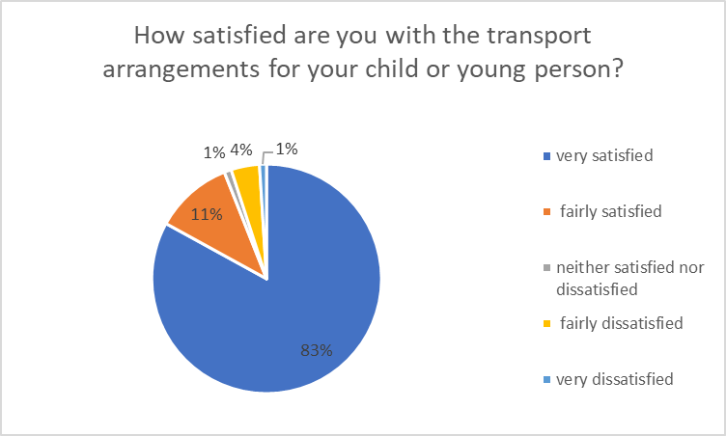
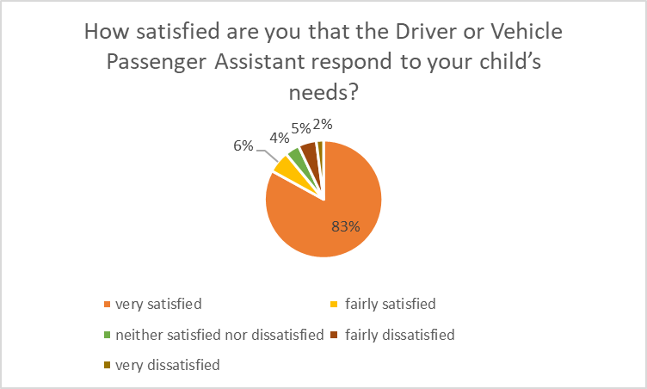
What people say about us?
94% of parents' carers are very or fairly satisfied with their child's current travel arrangements
89% of parents' carers are very or fairly satisfied their crew respond to their child's needs

Slide 7
Our new Contract
September 2023 until September 2027
How was it shaped?
Children and young people at the heart
Safety and safeguarding a priority
Raising the bar
SEND

Slide 8
What our new contract says?

Slide 9
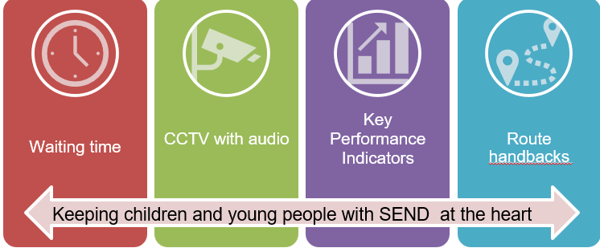
What our new contract says

Slide 10
How will we manage the contract?
Spot checks
Termly Contract Review Meetings
Key Performance Indicators
Satisfaction Surveys
Contract Compliance Meetings

Slide 11
How we will manage the contract?
I don’t quite understand…
Tell us more about...
My worry is that...
My suggestion is…

Slide 12
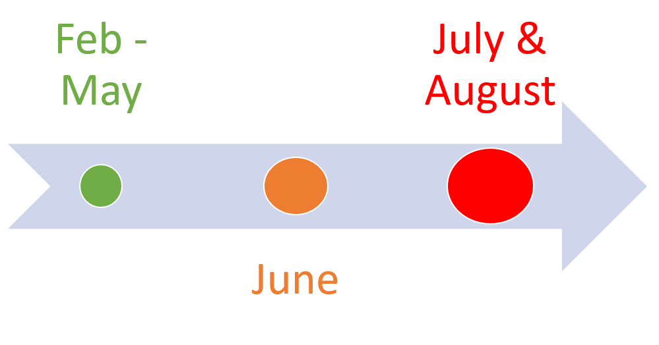
Getting ready for September 2023
Deadlines! EHCPs & Application and Pupil Travel Information Forms

Slide 13
Getting ready for September 2023
Our Transport Panel – Team Manager, SEND Officer, Amaze, Transport Officer
Every Tuesday
Panel Checklist
Letting you know
No need to re-apply if your child already has home to school transport

Slide 14
Getting ready for September 2023
Safe, suitable, reasonably stress-free travel
Risk assessments
45 minutes primary school aged children
75 minutes secondary school aged children

Slide 15
Getting ready for September 2023
200+ addresses
Distance to each other and school
Understanding your child's needs and travel requirements
600+ children
70+ schools and colleges

Slide 16
Getting ready for September 2023
Co-produced route planning principles
Balancing the comfort, safety and wellbeing of all children
Best value for public money
Limitations
Alternative options

Slide 17
Ways you could use a Personal Travel Budget
Pay for a bus pass for your child or get a buss pass for you or a friend to go with your child
Pay for an assistant or child minder (with a DBS check) to take your child to school
Cover the cost of driving your car
Work with the school to car/taxi share / ‘walking buses’ with other parents
Paying for childcare/school clubs for your other children so you can travel with your eligible child to school

Slide 18
Getting ready for September 2023
I don’t quite understand…
Tell us more about...
My worry is that...
My suggestion is…

Slide 19
How we award your child's journey?
Passing information to the operators:
Name of child/ren
Address/es
Type of vehicle required
Travel requirements – medical equipment/ nursing or support staff etc
Plain English SEND profile/needs of the child/ren
Operators choose the journeys they want, and name their price = 'their bid'
The operator with the lowest bid is awarded the route, unless another operator better meets the needs of the child/ren - e.g., a driver who can sign to transport children who are Deaf
Let operators know the outcome
Operators arrange for crews to make introductions

Slide 20
How we award your child's journey?
I don’t quite understand…
Tell us more about...
My worry is that...
My suggestion is…

Slide 21
How we keep your child safe?
Before Travel
Enhanced DBS checks
Reference checks – new crew
Extensive HTST training, evidencing completion, repeated every 3 years & Crew handbook
Crew Code of Conduct
Safeguarding measures
Pupil Travel Information Forms
Pupil & vehicle risk assessments
Meet & Greets
Child Friendly Passenger Charter

Slide 22
Some examples of our training
Introduction to the role
Equalities and Diversity
Autism Spectrum Condition
SEND
Epilepsy
Behaviours that may challenge
Safeguarding
Language and Communication
Exploitation

Slide 23
How we keep your child safe?
During & After Travel
Spot checks
Responding to incidents
Emergency procedure
How we provide safe transport for children and young people who use wheelchairs or harnesses.
Route Review check ins
Coffee Mornings
Read more about Safety during home to school transport

Slide 24
How we keep your child safe?
I don’t quite understand…
Tell us more about...
My worry is that...
My suggestion is…

Slide 25
Timescales!
By 30th of April: all applications for –16 transport
By 31st of May: all applications 16+ transport
By 30th of June: Route Planning completed
By 31st of July: Route bidding, award, confirmation, Meet & Greets
By 31st of August: Meet & Greets
4th of September: Term starts (for most pupils)

Slide 26
Why is this going to be tricky?
Council naming settings in EHCPs
Timeliness of applications and Pupil Travel Information Forms
Completion of risk assessments (including schools)
Operators ensuring crews are DBS & reference checked and trained
Crew availability over the summer
Parents carers availability over the summer
Timeliness of Operators bidding on routes
Timeliness of route awards
Operators handing back routes
Crew swaps
Timeliness of Operators arranging Meet & Greets
Delays and disruption to pupil travel

Slide 27
Why is this going to be tricky?
I don’t quite understand…
Tell us more about...
My worry is that...
My suggestion is…

Slide 28
How to apply?
Any applications for free transport can be made through our online portal:
Apply for help with home to school transport (brighton-hove.gov.uk)
If anyone needs help to complete the application form or would like the application in another language –
we can support you.

Slide 29
Thank you and Questions
Thanks so much for giving us your time and support today.
If you have any further questions, please do email us at HometoSchoolTransport@brighton-hove.gov.uk
or if you would like to ask a question confidentially,
please contact admin@paccbrighton.org.uk

