Slide 1
Families, Children and Learning
SEN Education Personal Budgets pilot
November 2024

Slide 2
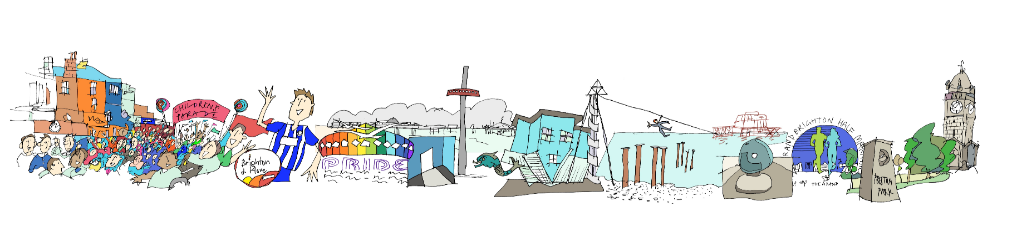
Outcomes
Walk through the sampling findings, and pilot process
Get views and talk about next steps

Slide 3
Case Sampling
A sampling of current education personal budgets was carried out
We have 30 cases of Education personal budgets currently
This is a small percentage of the total number of EHC Plans

Slide 4
Findings
Most of the cases are at secondary age
Main needs of pupils requiring an education personal budget are Autism and Social, Emotional and Mental Health
A personal budget was agreed when education other than in school (EOTIS) was required
Some cases moved to Brighton and already had an education personal budget
3 cases were tribunals
Despite these cases being a very small cohort, they take up a lot of the SEN Team resources in terms of casework team time
The process wasn’t clear for families

Slide 5
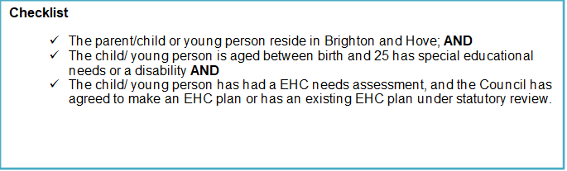
Making a request

Slide 6
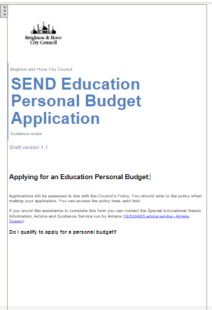
Application form
Piloting an application form
This has a checklist for families
Sections link to the EHC plan outcomes
Parents/carers can specify if they want a direct payment or a notional arrangement
Considered by panel – will look at whether needs and provision can be met in an education setting

Slide 7

Next steps
Get views of families going through the process
Finalise the application and information for families
Ensure webpages are updated with the new policy and information for families

