Slide 1
National Wraparound Childcare Programme
November 2024

Slide 2
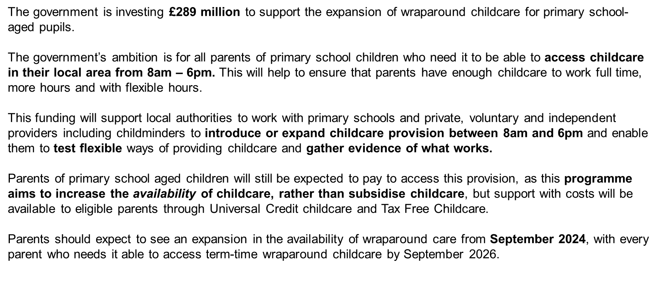
Families, Children and Learning
Overview of the National Wraparound Childcare Programme

Slide 3
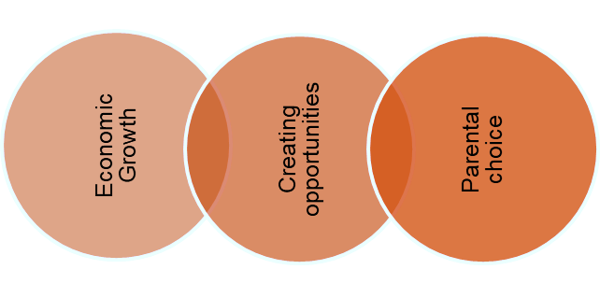
To increase parents’ participation in the labour market, by ensuring that every parent/carer of primary age children who needs wraparound has access to wraparound childcare in their local area. We will do this by increasing the availability of provision.

Slide 4
Delivery Models
School-based provision, delivered by school
Private provider-run provision, on or off school site
Community model
Delivered by school staff on school site, open to all children in that school.
Operated and delivered by staff employed by private provider. If on school site, they may pay school to operate wraparound provision on their premises and advertise via school channels. Could operate on other sites too.
Local authority co-ordinates a community-focused cluster / hub model, with children from multiple schools on one site. Not necessarily linked to any one school. Run by private provider, community organisation or any other appropriate body.
Childminders
Other EY providers
Provision delivered by childminders, signposted to parents by local authority and schools. Could be a group of CMs working together on a single/community site.
Existing EY providers may take older children (i.e. of school-age) during wraparound hours. For example, a play group operating on a school site may run the provision, or a local nursery.

Slide 5
Grant allocation to Brighton & Hove
Wraparound programme maximum grant allocation (2024-2026), which includes internal capacity cost:
 | Wraparound Programme Grant Allocation
 | FY 23-24 | FY 24-25 | FY 25-26 | Total
Brighton & Hove | £10,758.08 | £554,415.13 | £263,206.18 | £828,379.39
Childcare Expansion Capital Grant by the DfE to support the expansion of childcare places, both for early years and for wraparound childcare:
 | Childcare Expansion Capital Grant Allocation
 | Total | Early Years (80%) | Wraparound (20%)
Brighton & Hove | £412,289 | £329,831 | £82,458
Notes:
The DfE distributed the funding at national level with 80% for early years provision and 20%, which is £82,458, for the wraparound programme.

Slide 6
Families, Children and Learning
What programme funding can be used for ?
Can be used for:
Staffing;
Training including specialist training for staff to ensure they feel equipped to support children with additional needs;
Transport costs;
Resources;
Running costs whilst demand builds (to remove any financial risk to providers of offering additional places before demand is guaranteed).
Should not be used for:
Subsidising cost of places, as new places created by the programme should be paid for by parents;
Running costs for existing wraparound childcare places;
Equipment or supplies which have an expected shelf life of more than one year where either the purchase price is in excess of £500 or is a group of lower value items where the combined value is in excess of £500.

Slide 7
Families, Children and Learning
What capital funding can be used for ?
Can be used for:
Building modifications to enable use of space outside main school/setting operating hours, e.g., secure external access, outside lighting to enable outdoor space to be used year-round;
Should not be used for:
Routine maintenance or refurbishment of premises;
Building modifications to adapt space for use to deliver inclusive wraparound childcare, e.g., works to improve facilities for children with SEND;
Provision of storage/ outdoor shelters;
Providing or upgrading a kitchen/food prep and storage area;
Purchasing new fixed assets required to deliver wraparound provision such as play equipment (including outdoor play equipment), or tables and chairs. To be considered capital expenditure the asset must bring an economic benefit, and able to be depreciated, over more than one financial year.
Capital works to maintain and improve the condition of the school estate;
Revenue expenditure of any kind, such as training and staff cost, resources/assets that do not meet the definition of capital expenditure given above (such as toys, books, clothing), etc.

Slide 8
Families, Children and Learning
DfE Guidance for Schools
Communicate the local available offer to parents of the children that attend their school to ensure equal opportunities for all children.
Work with the local authority wraparound lead and others in the sector, to identify how they can support parents to access wraparound childcare.
Run their own wraparound care or have a private, voluntary and independent (PVI) provider on the school site unless there is a reasonable justification not to (having considered all support available, in particular from the national wraparound childcare programme).
Signpost parents to appropriate provision, if they are unable to have wraparound on the school site.
DfE Guidance for schools and trusts

Slide 9
Families, Children and Learning
Progress Overview
Autumn MI return: Out of 176 new places created, by Oct 2024, 8 places are now being accessed by children who have an EHCP, the number is expected to grow.
Where we have funded new provision and while demand is still building and not at full capacity, we encourage providers to use this to meet the needs of children with SEND, supporting them to settle and this has worked well.
Schools and providers are adapting space to deliver inclusive wraparound childcare using capital grant, e.g., Sensory room, bell tent, calming sensory pod, and other SEND equipment like bubble tube etc.

Slide 10
Families, Children and Learning
Special schools
Hill Park School
Downs View School
We are providing support to private, voluntary and independent (PVI) providers that would like to set up wraparound provision for the Downs View school.
We are also supporting Little Lambs Kindergarten with their proposed SEND offer picking up from Hill Park School.

Slide 11
Families, Children and Learning
Next Steps
Parental engagement
Training offer
Childminder campaign

Slide 12
Thank you!

