Slide 1
Draft Slides
PACC Connect Event 3rd June 2025

Slide 2
Agenda and welcomes
Brighton and Hove Graduated response
Break
Priority 2 admissions information
Question and Answers

Slide 3
Ordinarily available provision. Whole School Inclusive Ethos and Culture, neurodiverse aware practice (e.g. BHISS training, Autism Aware Award) Or
Resource Provisions in mainstream schools
Special School Satellites
Special
School
EHCP support in mainstream with ARs reviewing progress and effectiveness of support
Special Facilities & Centres in mainstream schools
Assess Plan Do Review Cycle: SEN Support and intervention for pupils and families (this includes external support from support Services)
Inclusion Intervention spaces in mainstream schools – small group support (pilot). Tier 1
Alternative Provision (targeted support, time limited placements and transitional placements). Tier 2 & 3
Special Educational Needs and Disability graduated response

Slide 4
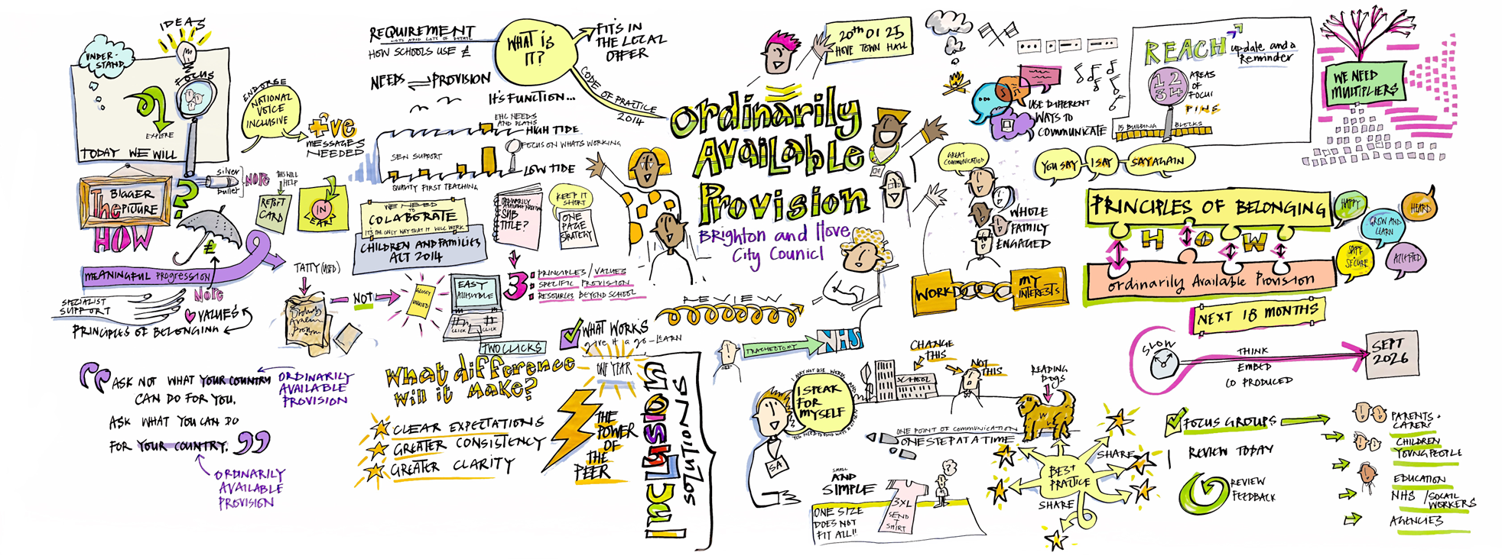
Ordinarily Available Provision

Slide 5
Ordinarily Available Provision for SEND Guidance
Work has now started in earnest to develop the first Co-produced draft of an Ordinarily Available Provision (OAP) for SEND guidance. We have been meeting with a wide range of stakeholders including Head Teachers, SENCOs, parents/carers, BHISS team members and children and young people to gather a range of views on what should be included.
This guidance will outline the support and strategies that mainstream educational settings should 'reasonably' provide to meet the needs of CYP with SEND without requiring an EHCP.
The purpose of this guidance is to:
Promote inclusive education by ensuring that all students, including those with SEND, have access to high-quality teaching and learning opportunities.
Define expectations for schools and early years settings regarding the provision of SEND support within their existing resources.
Encourage consistency across educational settings by setting out best practices for removing barriers to learning and fostering an inclusive environment.
Support educators in identifying and implementing effective strategies to meet the diverse needs of students with SEND.
Enhance outcomes for all learners by embedding inclusive teaching approaches that benefit both SEND students and their peers.
The guidance when completed (first draft expected July 2025) is designed for teachers, SENCOs, and school leaders, helping them create supportive learning environments that enable all students to thrive. It also serves as a reference for parents and carers to understand the provisions in schools, available for children with SEND.

Slide 6
Principles of Belonging: An Inclusion Charter for Brighton & Hove

Slide 7
Whole School Inclusive Ethos and Culture, Neuro-affirmative practice, cycle of support
Brighton and Hove Inclusion Support Service (BHISS) is a multi-disciplinary team that works with children & young people with special educational needs and disabilities (SEND), and their families, through schools and other education settings. BHISS also works closely with professionals within the Schools Mental Health Service.
Our experienced professionals work in the following teams to provide support: • Autism & Language: SEN Specialist Teachers & Practitioners • Early Years: SEN Specialist Teachers & Practitioners • Educational Psychology: Educational Psychologists • Literacy: SEN Specialist Teachers • Deafness & Visual Impairment: SEN Specialist Teachers & Practitioners • Social, Emotional and Mental Health: SEMH Specialist Practitioners • Social Communication Resource (SCR): SCR co-ordinators
Whole school level work is aimed at increasing capacity to support children and young people who might have difficulty with attending and engaging. We have led on producing guidance documents for schools e.g. on attendance, SEND Guide, Sensory Differences, Attachment Aware, Literacy
Our practice involves using consultation, assessment, intervention, research, training and working systemically/strategically with schools and settings. Our school work is agreed in discussion with SENCO.
Assess Plan Do Review Cycle: SEN Support and intervention for pupils and families
Each school has a core/buy back offer based on need. This is reviewed on an annual basis.

Slide 8
Inclusion Intervention spaces in mainstream schools – small group support (pilot). Tier 1
Schools develop the intervention space
Managed by the school
Small provision within school linked to school need (e.g. 8 pupils)
Flexible provision to support wider SEND needs
Supports SEN support pupils and EHC plan pupils
Staffed with a Teacher and Teaching Assistant
Space allocated within school
Adapted and flexible curriculum
Children spend part of their day in their mainstream class
Appropriate environment

Slide 9
Inclusion Intervention spaces in mainstream schools – small group support (pilot). Tier 1
We are piloting this with 5 schools across the city this academic year
The schools are supported by a community of practice
A senior leader from school has been commissioned to support the pilot with support from BHISS
Inclusion Intervention Spaces started in January
Evaluation will be completed in June
Aim is to learn from year 1 and develop more IIS in primary mainstream schools each year growing this over time to ensure schools can be more inclusive

Slide 10
Developments in Alternative Provision in Brighton & Hove
Tier 1 – Targeted Support in Mainstream schools. The LA has provided financial and practical support to schools to enable them to develop Tier 1 AP support within their school settings.
Tier 2 – Adaptive Learning Provisions (ALPs) in Secondary Schools. Kate Barker (AP Lead) has been working with 4 secondary schools to develop Tier 2 ALP provisions. These provisions collectively provide 36-one term placements for children at risk of exclusion. ALPs accept referrals for a placement for a young person from within their own school settings and from other secondary schools across the city.
AP Specialist Task Force (APST). As part of the SEND & AP Change Programme we have been piloting an APST model. The team comprising a wide range of professionals are currently co-located at the Lynchet Close PRU site. The team work with CYP and their families who are most at risk of disengagement, violence and criminal activity. We plan to extend this model to provide outreach support to schools from September 2025.
Tier 2 – Pupil Referral Unit placements (registered provision). Together with the Head Teacher of Central Hub Brighton, we have created a number of one-term assessment placements for both KS2 pupils at Fairlight Primary school and secondary aged KS3/4 pupils at Lynchet Close.
Tier 2 – Unregistered Alternative Provision. Katie Rowe (AP commissioner) has been working to develop an AP Approved Providers directory for BHCC. The Directory will soon be available for Parents/Carers to access via the Council website. Approved Providers are required to participate in a Quality Assurance and Safeguarding checks process before becoming 'approved.' Tier 2 unregistered AP is usually commissioned by schools as part of a flexible timetable. Parents/carers seeking an AP placement for their child should contact their child's SENCO to discuss this in the first instance.
Tier 3 – Transitional Placements. Transitional placements are provided by Central Hub Brighton (PRU) and support children with SEMH needs who require a longer-term placement whilst they transition to another mainstream setting, a specialist setting or a Post-16 educational placement. Tier 3 placements are currently offered at Connaught Road (KS2) and The Connected Hub (Year 11)

Slide 11
EHCP support in mainstream with Annual Reviews - progress and effectiveness of support
We have trained 150+ SENCOs in person centred reviews over 2 academic years
We developed guidance and tools
A person-centred review has the child or young person at the centre of their review meeting
It uses tools that are positive and celebrate the child and their progress
What we like and admire about them
What is important to them
What's working and not working
What good support looks like
Pupil views
Reviewing outcomes and support

Slide 12
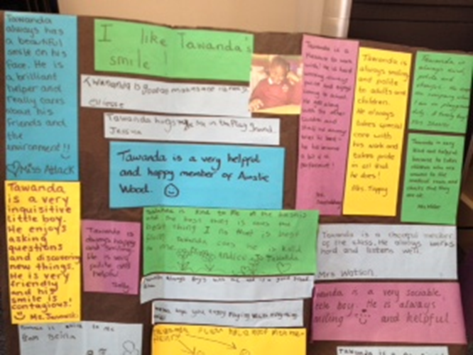
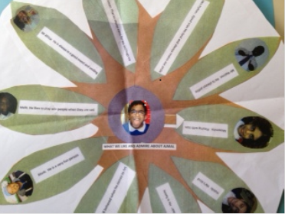

Slide 13
Specialist Provision development
Resource provision is being developed in 2 primary schools in the centre and east of the city. This will provide an extra 28 places for Autism
We are looking at developing a resource provision in secondary to enhance the offer of 20 places
The Hive opened in 2023 with 34 places and has grown to 61 places in secondary
We piloted a 1-year transition 6th form at the Cullum Centre to support pupils with Autism into Further Education. This was evaluated as successful and will continue
We closed Homewood College and opened St Georges House Key stage 4 provision
We have developed specialist middle school places at Connaught Road for SEMH
A primary PRU will be based at Fairlight School from September 2025.

Slide 14
Specialist Provision development
Developing a SEND sufficiency educational plan to oversee the provision of SEND places for the city. Immediate priorities are set out above.
In addition to the immediate priorities, we want to develop more specialist and outreach provision for primary aged neurodiverse children.
We also want to look at provision for children starting school with social, emotional and mental health needs and more complex SEND so that they can be successful in the mainstream setting.
Over the next 3 years, Headteachers, officers and PaCC will be looking at the continuum of provision for all needs in the city and assessing future developments.

Slide 15
Questions and Answers

